Slide 1
“Automating Reasoning on Conceptual Schemas” in FamilySearch — A Large-Scale Reasoning Application
TM
More questions than answers … help!
But possibly also some interesting directions for future research …
David W. Embley
Brigham Young University
BYU Data Extraction Research Group
Notes:
Directly addresses many of the issues stated in the seminar overview:
Verification (internal correctness) & Validation (corresponds to requirement specs)
Question raised in the overview:
- Is there any decidable subset of ER/UML/ORM that is expressive enough to be used in real applications?
- Does it make sense to renounce to decidability to be able to handle the full expressive power of ER/UML/ORM with and without textual integrity constraints?
- Which is the current state of the achievements as far as reasoning on the behavioral part is concerned?
- How efficient are the current proposals to be able to automatically reason about conceptual schemas in practice?
BTW – there is also a formal behavioral component (OBM & OIM) that may be of interest to consider (They’re looking for the current state of achievement as far as reasoning on behavior is concerned.) Thus, I plan to add this as an aside.
Questions:
OSM formalism in light of the verification & validation and the other issues of the seminar: is the ORM subset we use expressive enough?, to what extent is the subset decidable? cost of features if not decidable? resolution of issues running the tableaux algorithm to check satisfiability? what about OBM & OIM, behavioral reasoning? (verification issues: internal consistency)
The answers to FamilySearch reasoning appear to be in the realm of automating reasoning on conceptual schemas. The wiki perspective changes the rules: the data stored routinely violates the constraints. Some of the constraints are probabilistic.
Reasoning over the data: FROntIER (validation issues: does the schema, including the implied schema elements, meet the requirements of the application?)
Constraint violations in the data: loops in genealogical pedigrees and other constraint violations?
Probabilistic constraints: what happens when we add probabilities? (e.g., probability distributions for cardinalities, probability of correctness of base assertions, probability of inferred insertions, probability of constraint violations)

Slide 2
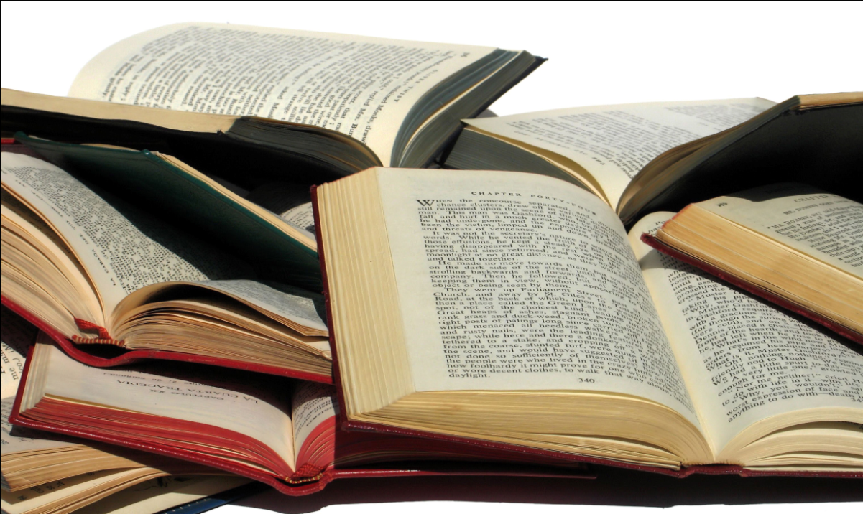
Context: Web of Knowledge Supermposed Family History Books
Large collection of scanned, OCRed books: currently 85,000 on line and counting
Stated assertions
Implied assertions
Inferred
Same-as entities
4.25×10¹² assertions
Trillions of RDF triples
Notes:
Scenario (HIP) & the roles of conceptual modeling
Questions (example problems)
OSM (as the basis for the reasoning tasks in the scenario)
Tableaux algorithm problem? (CS652 Fall12 notes)
Additional useful? features (e.g., n-ary): decidable? Tractable?
Practical application of OSM^{+p}:
Scaling up reasoning? (FROntIER)
Detecting constraint violations? (Loops, …)
How to incorporate probabilistic constraints? (Woodfield, …)

Slide 3
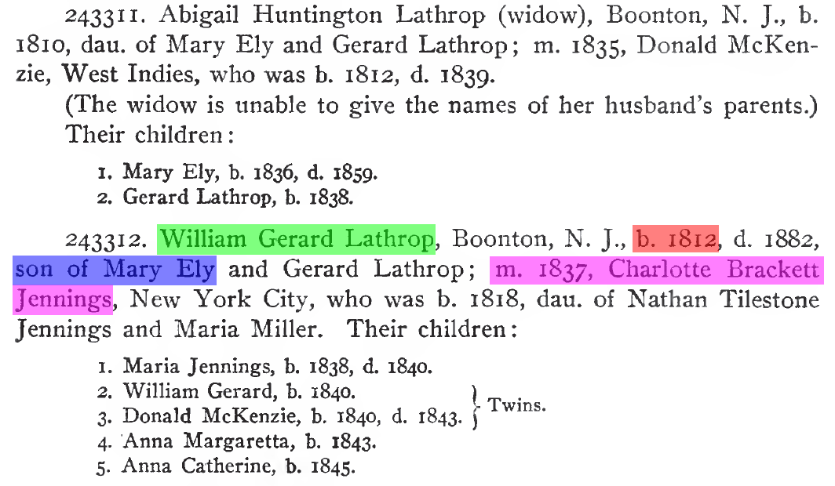
Stated Assertions
William Gerard Lathrop
married Charlotte Brackett Jennings in 1837
is the son of Mary Ely
was born in 1812

Slide 4
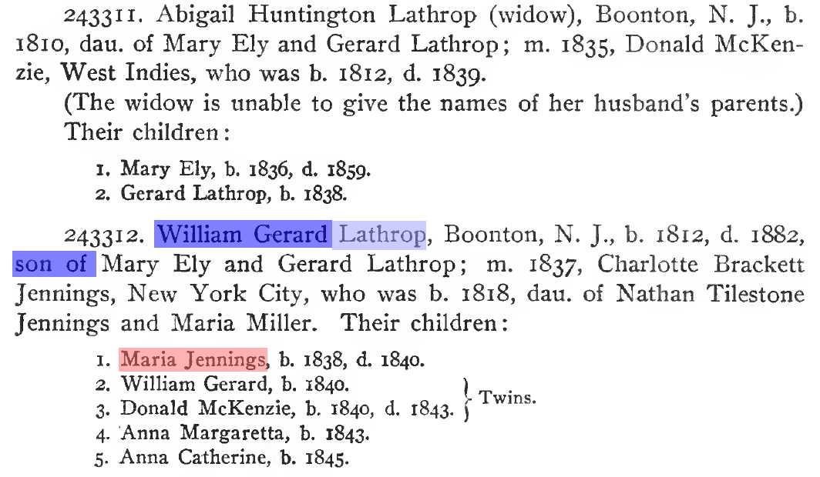
Inferred Assertions
William Gerard Lathrop has gender Male
Maria Jennings Female (name analysis)
Maria Jennings has surname Lathrop

Slide 5
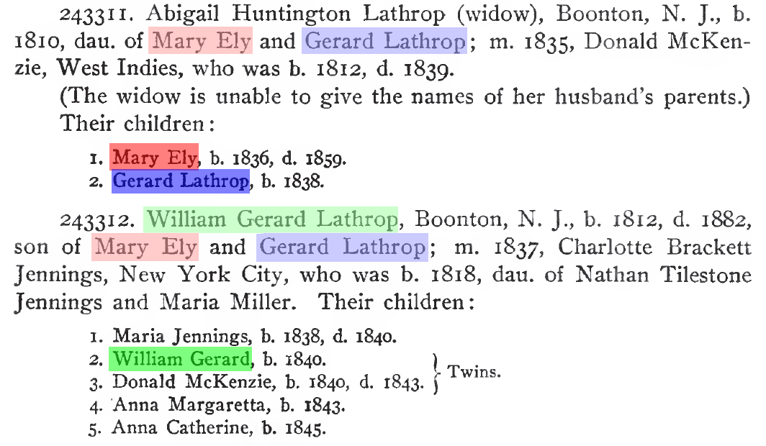
Same-as Entities
William Gerard Lathrop
Gerard Lathrop
Mary Ely

Slide 6
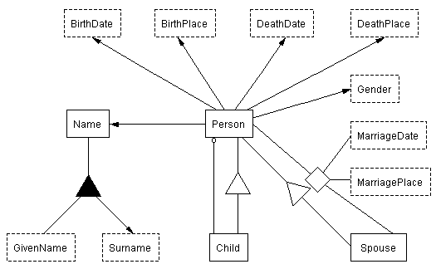
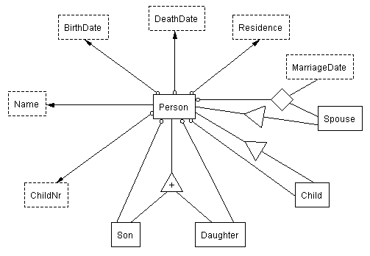
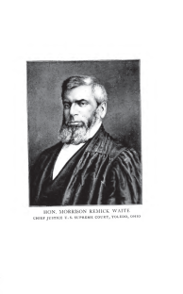
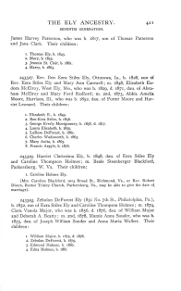
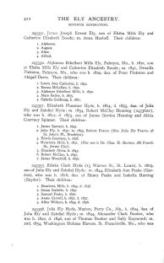
FROntIER
<owl:Thing rdf:ID="Person_1"/>
<owl:Thing rdf:about="#Person_1">
<rdf:type rdf:resource="&family;Person"/>
<rdf:type rdf:resource="&family;Child"/>
<rdf:type rdf:resource="&family;Spouse"/>
</owl:Thing>
<owl:Thing rdf:ID="Name_1"/>
<owl:Thing rdf:about="#Name_1">
<rdf:type rdf:resource="&family;Name"/>
</owl:Thing>
<owl:Thing rdf:ID="GivenName_1"/>
<owl:Thing rdf:about="#GivenName_1">
<rdf:type rdf:resource="&family;GivenName"/>
</owl:Thing>
<rdf:Description rdf:about="#GivenName_1">
<family:GivenNameValue rdf:datatype="&xsd;string">Abigail</family:GivenNameValue>
</rdf:Description>
<owl:Thing rdf:ID="GivenName_2"/>
<owl:Thing rdf:about="#GivenName_2">
<rdf:type rdf:resource="&family;GivenName"/>
</owl:Thing>
<rdf:Description rdf:about="#GivenName_2">
<family:GivenNameValue rdf:datatype="&xsd;string">Huntington</family:GivenNameValue>
</rdf:Description>
<owl:Thing rdf:ID="Surname_1"/>
<owl:Thing rdf:about="#Surname_1">
<rdf:type rdf:resource="&family;Surname"/>
</owl:Thing>
<rdf:Description rdf:about="#Surname_1">
<family:SurnameValue rdf:datatype="&xsd;string">Lathrop</family:SurnameValue>
</rdf:Description>
<owl:Thing rdf:ID="BirthDate_1"/>
<owl:Thing rdf:about="#BirthDate_1">
<rdf:type rdf:resource="&family;BirthDate"/>
</owl:Thing>
<rdf:Description rdf:about="#BirthDate_1">
<family:BirthDateValue rdf:datatype="&xsd;date">1810-00-00</family:BirthDateValue>
</rdf:Description>
<owl:Thing rdf:ID="MarriageDate_1"/>
<owl:Thing rdf:about="#MarriageDate_1">
<rdf:type rdf:resource="&family;MarriageDate"/>
</owl:Thing>
<rdf:Description rdf:about="#MarriageDate_1">
<family:MarriageDateValue rdf:datatype="&xsd;date">1835-00-00</family:MarriageDateValue>
</rdf:Description>
<owl:Thing rdf:ID="Gender_1"/>
<owl:Thing rdf:about="#Gender_1">
<rdf:type rdf:resource="&family;Gender"/>
</owl:Thing>
<rdf:Description rdf:about="#Gender_1">
<family:GenderValue rdf:datatype="&xsd;string">Female</family:GenderValue>
</rdf:Description>
<rdf:Description rdf:about="#Person_1">
<family:Person-BirthDate rdf:resource="#BirthDate_1"/>
<family:Person-Name rdf:resource="#Name_1"/>
<family:Person-Gender rdf:resource="#Gender_1"/>
<family:Person-Child rdf:resource="#Person_5"/>
<family:Person-Child rdf:resource="#Person_6"/>
</rdf:Description>
<rdf:Description rdf:about="#Name_1">
<family:Name-GivenName rdf:resource="#GivenName_1"/>
<family:Name-GivenName rdf:resource="#GivenName_2"/>
<family:Name-Surname rdf:resource="#Surname_1"/>
</rdf:Description>
<owl:Thing rdf:ID="PersonMarriageDateMarriagePlaceSpouse_1"/>
<rdf:Description rdf:about="#PersonMarriageDateMarriagePlaceSpouse_1">
<family:PersonMarriageDateMarriagePlaceSpouse-Person rdf:resource="#Person_1"/>
<family:PersonMarriageDateMarriagePlaceSpouse-Spouse rdf:resource="#Person_4"/>
<family:PersonMarriageDateMarriagePlaceSpouse-MarriageDate rdf:resource="#MarriageDate_1"/>
</rdf:Description>
RDF output
convert to RDF
Jena reasoner
parameters
comparators
OntoES
convert to csv
owl:sameAs
Duke
[(?x rdf:type source:Person) -> (?x rdf:type target:Person)]
[(?x source:Person-Name ?n),(?n source: NameValue ?nv),
isMale(?nv),makeTemp(?gender)
-> (?x target:Person-Gender ?gender),(?gender rdf:type target:Gender),
(?gender target:GenderValue `Male'^^xsd:string)]
Notes:
4.25x10^12 = 4.25 trillion triples
FROntIER = Fact Recognizer for Ontologies with Inference and Entity Resolution

Slide 7
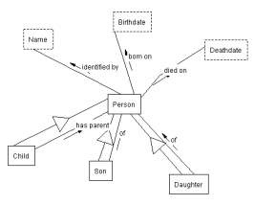
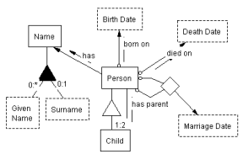
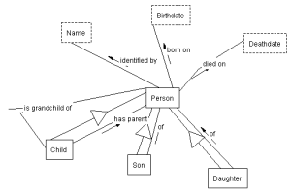
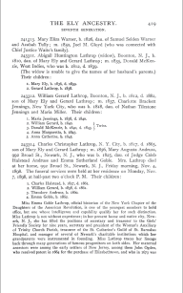
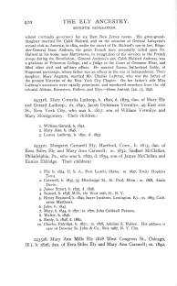
WoK (a Web of Knowledge superimposed over historical documents)
…
…
…
…
Notes:
Automatic extraction builds links.
4.25x10^12 = 4.25 trillion triples

Slide 8
WoK (a Web of Knowledge superimposed over historical documents)
grandchildren of Mary Ely
…
…
…
…
Notes:
Automatic extraction also builds query links.

Slide 9
WoK (a Web of Knowledge superimposed over historical documents)
grandchildren of Mary Ely
…
…
…
…
Notes:
Selection of best ontology to answer query.

Slide 10
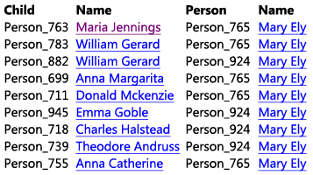
WoK (a Web of Knowledge superimposed over historical documents)
grandchildren of Mary Ely
…
…
…
…

Slide 11
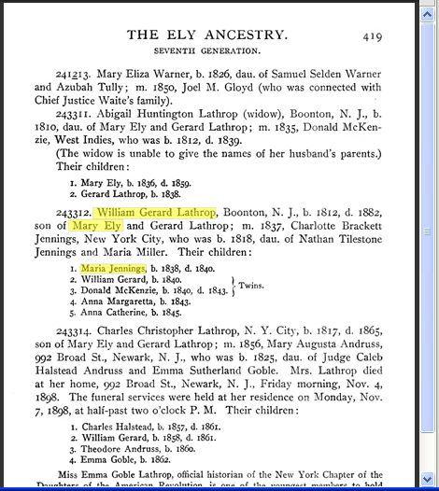
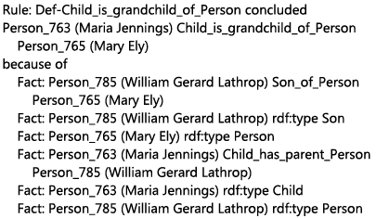
WoK (a Web of Knowledge superimposed over historical documents)
grandchildren of Mary Ely
…
…
…
…
Notes:
Mockup as designed. Actual implementation quite close. The differences point to where we need to add finishing touches.

Slide 12
Issues
Inference with large sets of assertions
Satisfiability over more expressive constraints
Uncertainty
Constraint violation search
Probabilistic description logics
Notes:
Abstract. Among its many other projects, FamilySearch.org has scanned and OCRed 85,000 books filled with family-history information—an estimated 4.25×10¹² “facts” of interest. We wish to extract and organize these facts for semantic search with respect to a conceptual model. Reasoning applies in several ways: (1) traditional satisfiability checks over potentially more expressive constraints, (2) inference with large sets of assertions—about half of the facts are inferred; (3) constraint violation search —unlike many database applications, it’s almost certain that the facts will not satisfy the constraints of the conceptual model, so finding the myriad of discrepancies is of interest; and (4) uncertainty —both facts and constraints are uncertain, so probabilistic description logics are of interest.

Slide 13
Q1: Scalability?
4.25 × 10¹² assertions, about half inferred
Conceptual model growth (via new inferred assertion types)
(Dynamic) semantic index
Notes:
Scalability in automated reasoning? Trillions of triples.

Slide 14
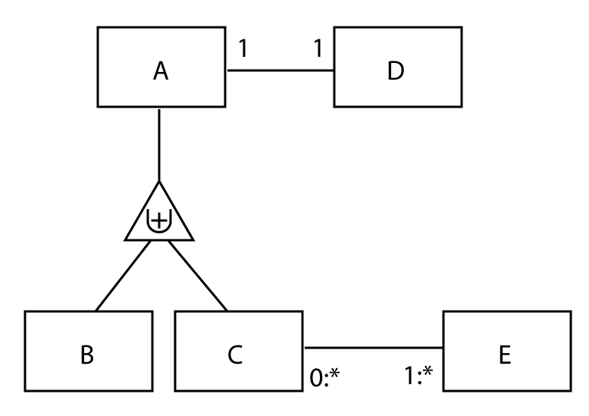
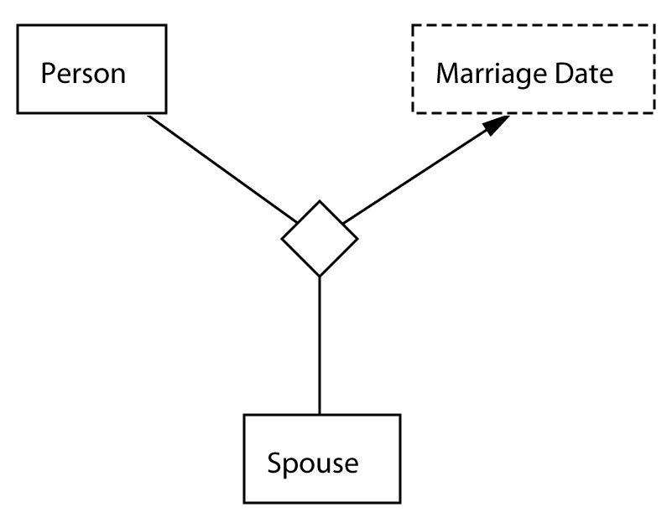
Q2: Satisfiability?
Basic Tableau Algorithm & OSM?
n-ary (n > 2)?
(≥1 AD) Π (≤1 AD)
(≥1 AD ⁻) Π (≤1 AD ⁻)
(≥1 CE ⁻)
¬B A
¬C A
¬A B C
¬B ¬C
x
y
z
w
Π
Π
Π
Π
x
y
v
Π
Marriage
Notes:
Checks over Potentially More Expressive Constraints – including probabilistic constraints, covered in the next section
CM written in predicate logic in this way … and in description logic this way … and satisfiable (as red shows), but tableau alg. doesn’t work for me …

Slide 15
Q3: Uncertainty?
How do we verify assertions?
Plato: “Knowledge is justified true belief”
WoK perspective: Reasoning chains grounded in source documents
Well-reasoned explanations
Where does uncertainty arise?
Assertion extraction
Assertion Inference
Object identity resolution
FamilySearch wiki model
What conceptual modeling constructs would be useful?
Probability of assertion correctness
Probability distributions for cardinality constraints
Probabilities and probability distributions over general constraints
Processing with uncertainty?
Satisfiability in the context of uncertainty
Discovering discrepancies
Likely views
Notes:
Plato: “Knowledge is justified true belief” – philosophers and others have been concerned with this. The WoK is a web of knowledge, and therefore the assertions should be justified.

Slide 16
Uncertainty: Truth Verification
Plato: “Knowledge is justified true belief”
grandchildren of Mary Ely
…
…
…
…
Plus: discussion (hopefully well-reasoned)
Notes:
New FamilySearch web site: new.familysearch.org … extr…4…

Slide 17
Source of Uncertainty: Assertion Extraction
<C>1</C>. <FN>Andy</FN> b. <BD>1816</BD>
2. Becky Beth h, i818
3. Charles Conrad
ListReader Wrapper Induction:
Precision: 95%
Recall: 91%
Initialize
C FN BD
\n(1)\. (Andy) b\. (1816)\n
Generalize
C FN BD
\n([\dlio])[.,] (\w{4}) [bh][.,] ([\dlio]{4})\n
Alignment-Search
Expansion
Insertion
Deletion
Many more …
C FN Unknown BD
\n([\dlio])[.,] (\w{4,5}) (\S{1,10}) [bh][.,] ([\dlio]{4})\n
C FN BD
\n([\dlio])\[.,] (\w{4}) [bh][.,] ([\dlio]{4})\n
X
Evaluate (edit sim. * match prob.)
1. Andy b. 1816
2. Becky Beth h, 1818
3. Charles Conrad
1. Andy b. 1816
2. Becky Beth h, 1818
3. Charles Conrad
One match!
No Match
<C>1</C>. <FN>Andy</FN> b. <BD>1816</BD>
2. Becky <MN>Beth</MN> h, i818
3. Charles Conrad
Active Learning
C FN MN BD
\n([\dlio])[.,] (\w{4,5}) (\w{4}) [bh][.,] ([\dlio]{4})\n
Extract
<C>1</C>. <FN>Andy</FN> b. <BD>1816</BD>
<C>2</C>. <FN>Becky</FN> <MN>Beth</MN> h, <BD>i818</BD>
<C>3</C>. <FN>Charles</FN> <MN>Conrad</MN>

Slide 18
Source of Uncertainty: Assertion Inference
(?x source:Person-Name ?n), (?n source: NameValue ?nv),
isMale(?nv), makeTemp(?gender)
-> (?x target:Person-Gender ?gender),
(?gender rdf:type target:Gender),
(?gender target:GenderValue `Male'^^xsd:string)]
Name isMale?
Notes:
4.25x10^12 = 4.25 trillion triples

Slide 19
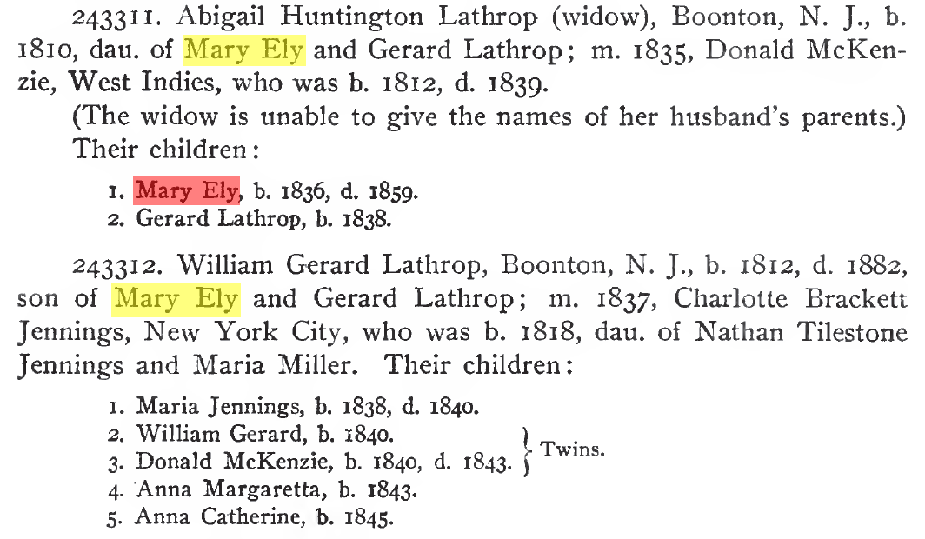
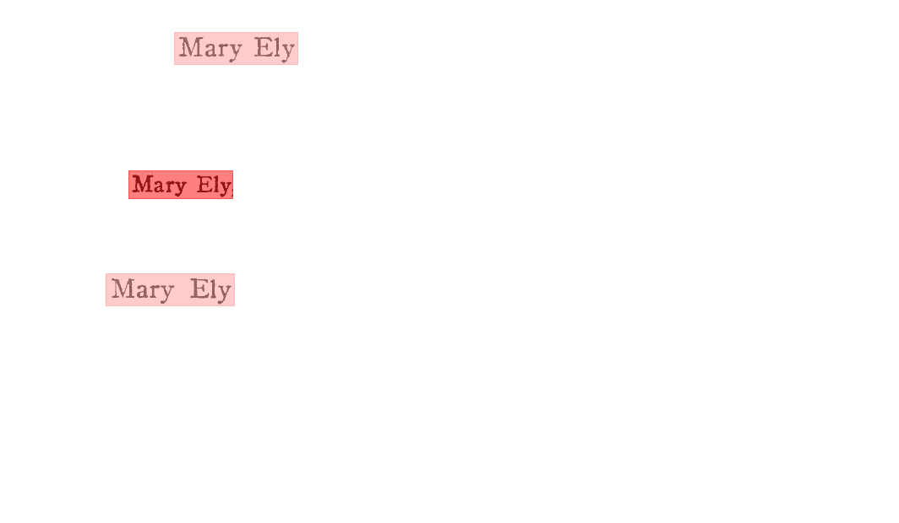
Source of Uncertainty: Object Identity Resolution
Person₂ (Mary Ely) owl:sameAs Person₈ (Mary Ely)
0.032081
0.995030
0.032081

Slide 20
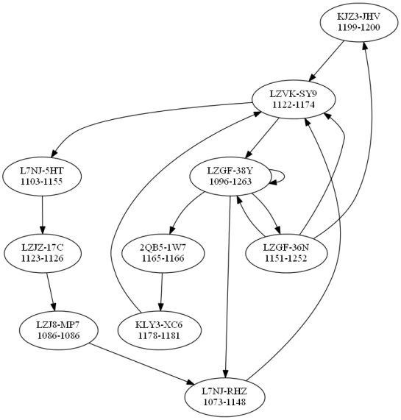
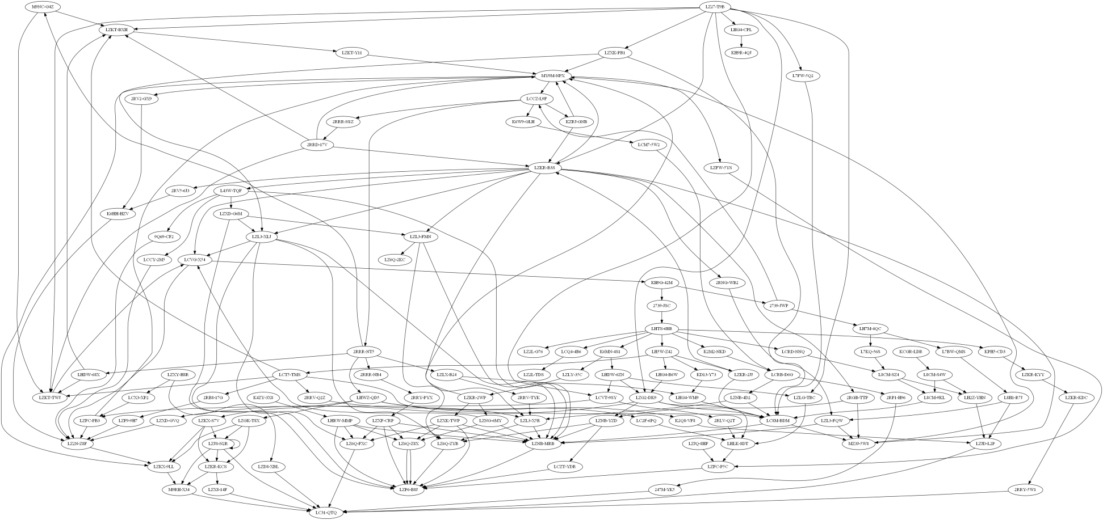
Source of Uncertainty: Wiki-like Updates + Uncertain Inferences
Cyclic Pedigree:
Sources of error:
Incorrect person merges
Incorrect parent-child relationship assertions
Notes:
Real loop. Each node is a person with ID and birth-range. A result of incorrect merges compounded with incorrect parent-child relationships. Arose as a result of combining information from a number of sources into the common pedigree + allowing wiki-like assertions from patrons.

Slide 21
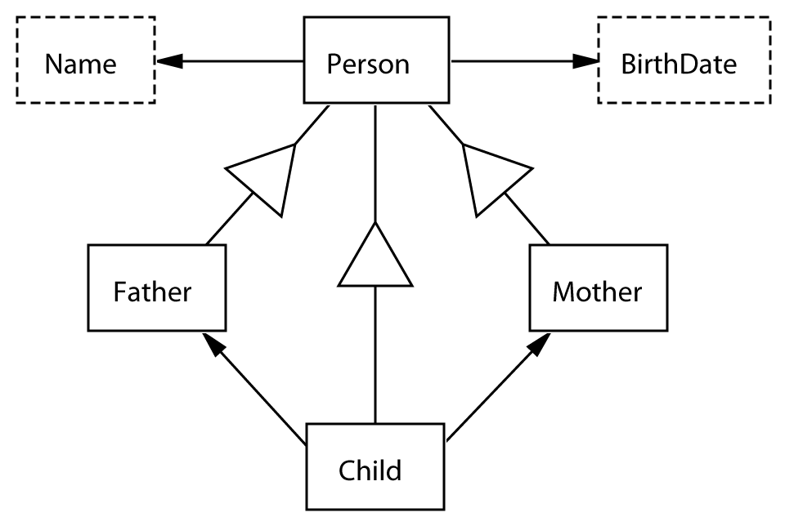
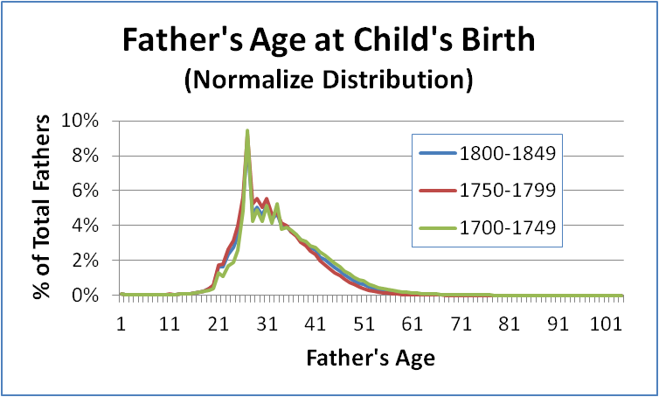
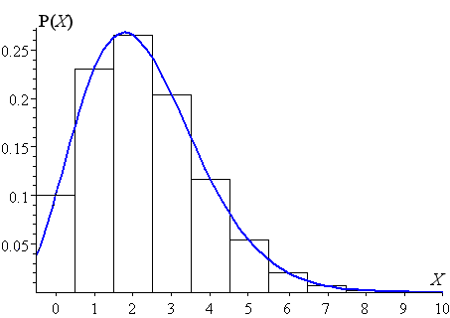
Uncertainty: Useful More-Expressive Conceptual Model Specifications
p = 0.79
2 Nov 1846
x
1 Nov 1845
p = 0.35
1:*
1:2.1:*

Slide 22
Uncertainty Processing: (1) Satisfiability, (2) Discrepancy Discovery, (3) Likely Views
p = 0.79
2 Nov 1846
x
1 Nov 1845
p = 0.35
1:*
1:2.1:*

Slide 23
Summary
Web of Knowledge (WoK)
Resolution needs:
Scalability
Satisfiability
Uncertainty
Conceptual-modeling extensions supporting uncertainty
Discrepancy discovery
View likelihood
www.deg.byu.edu
Notes:
Resolution needs:
Scalability (inference with large sets of assertions)
Satisfiability (basic check over potentially more expressive constraints)
Uncertainty (of both assertions and constraints)
Constraint violations (finding discrepancies with probabilistic truth)
Abstract. Among its many other projects, FamilySearch.org has scanned and OCRed 85,000 books filled with family-history information—an estimated 4.25×10¹² “facts” of interest. We wish to extract and organize these facts for semantic search with respect to a conceptual model. Reasoning applies in several ways: (1) traditional satisfiability checks over potentially more expressive constraints, (2) inference with large sets of assertions—about half of the facts are inferred; (3) constraint violation search —unlike many database applications, it’s almost certain that the facts will not satisfy the constraints of the conceptual model, so finding the myriad of discrepancies is of interest; and (4) uncertainty —both facts and constraints are uncertain, so probabilistic description logics are of interest.

